Slide 1
Exploring Latino Acculturation Through Non-Parametric Cluster Analysis
Jessala A. Grijalva, PhD
Institute for Latino Studies

Slide 2

Challenging Binary Acculturation
The new mestiza copes by developing a tolerance for contradictions, a tolerance for ambiguity... She learns to juggle cultures. She has a plural personality, she operates in a pluralistic mode—nothing thrust out, nothing rejected, nothing abandoned.
- Gloria Anzaldúa, 1972

Slide 3
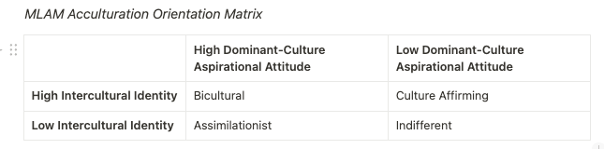
Multidimensional Latino Acculturation Model (MLAM)
A Novel Theoretical Framework

Slide 4
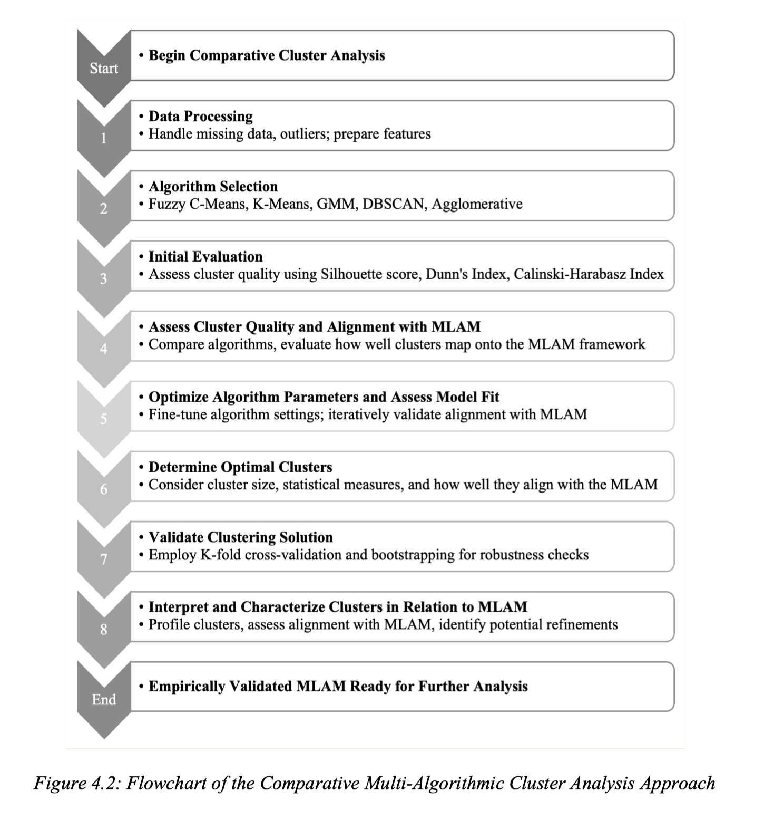
Data and Methodological Innovation
2006 Latino National Survey
• Nationally representative
• Independent assessment of identities
• Captures aspirational attitudes
• Subset analyzed: n=3,785 eligible Latino voters

Slide 5
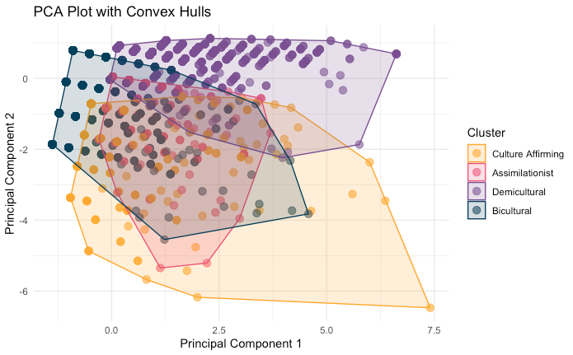
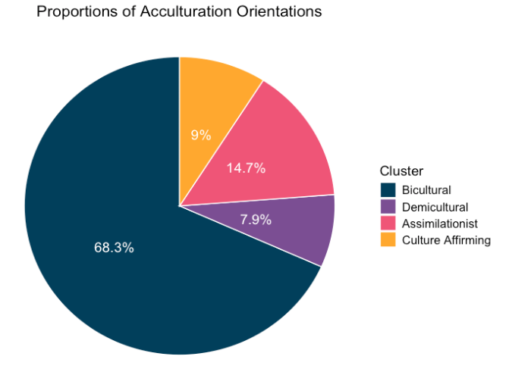
Emerging Patterns of Acculturation

Slide 6
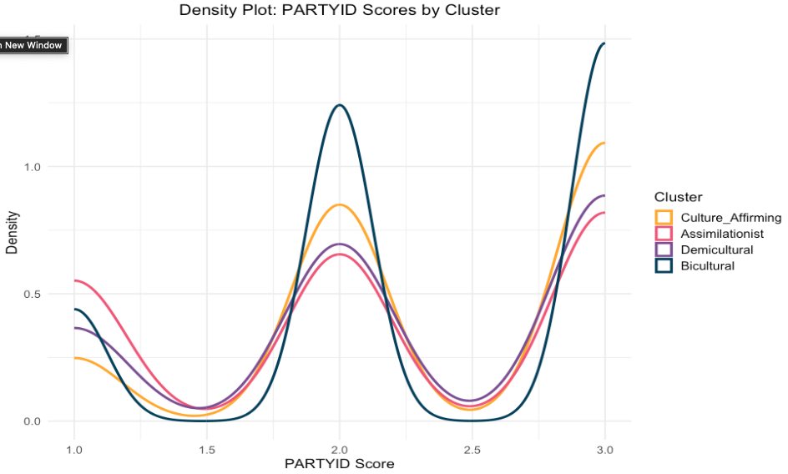
Political Dimensions of Acculturation

Slide 7
Rethinking Latino Political Behavior
Key Takeaways
• Binary models erase 76% of Latino acculturation experiences
• Acculturation orientations shape political behavior
• Binary frameworks fundamentally misrepresent Latino acculturation/experiences

Slide 8
Thank You!
jgrijalv@nd.edu

